Slide 1
vehicle insurance app

Slide 2
AGENDA
Introduction
Vehicle Insurance App Overview
Login Page
Registration Page
User Dashboard
Policy Management
Claims Submission
Settings Menu
Conclusion

Slide 3
INTRODUCTION
Welcome to the comprehensive Android app for vehicle insurance management.
This powerful application is designed to streamline our insurance experience, providing a seamless and user-friendly interface to
handle all your policy-related tasks. With this app, you'll have the convenience of managing your insurance information, submitting claims,
and staying up-to-date on your policy details right at our fingertips.
Whether you're a new policyholder or a seasoned customer, this app is our gateway to a hassle-free insurance journey

Slide 4
Vehicle Insurance App
Overview
1. Comprehensive Coverage: The app offers a wide range of insurance coverage options, including liability, collision, comprehensive, and more, ensuring we have the protection we need for our vehicle.
2. Personalized Dashboard: The user-friendly dashboard gives us a clear overview of our policy details, payment history, and upcoming renewals, making it easy to stay on top of our insurance information.
3. Streamlined Claims Process: Submitting a claim is a breeze with the app's intuitive claims submission feature. Simply upload the necessary documents and follow the step-by-step guidance to get our claim processed.

Slide 5
LOGIN PAGE
Secure Login:
The login page features robust security measures to protect our personal and financial information. we can securely log in using our registered email and password.
Forgot Password:
If we've forgotten our password, the app provides a convenient "Forgot Password" option that allows we to reset our credentials and regain access to our account.
Social Media Integration:
For added convenience, the app offers the option to log in using our existing social media accounts, such as Google or Facebook, streamlining the authentication process.

Slide 6
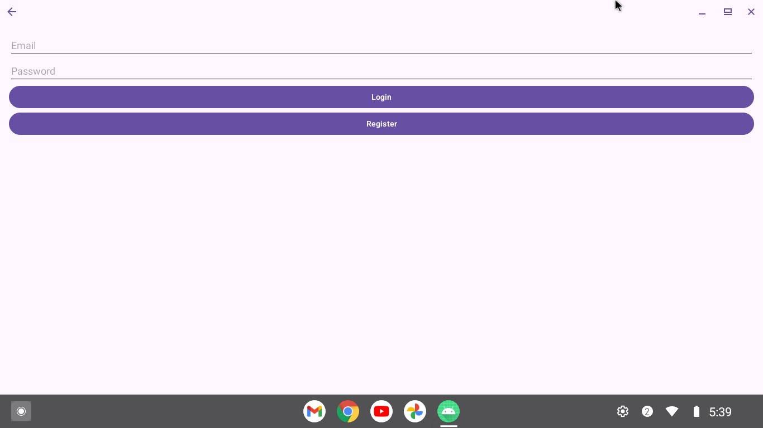
Login Page Results

Slide 7
REGISTER PAGE
Personal Information:
The registration process begins with entering our personal details, such as our name, date of birth, and contact information. This helps us create our unique profile and ensure accurate policy details.
Vehicle Details:
Next, we'll be prompted to provide information about the vehicle we would like to insure, including the make, model, year, and VIN. This data is crucial for determining the appropriate coverage and premiums.
Payment Options:
Finally, we'll have the opportunity to select our preferred payment method, whether it's a credit/debit card, bank account, or even automated recurring payments. This ensures a seamless and hassle-free billing experience.

Slide 8
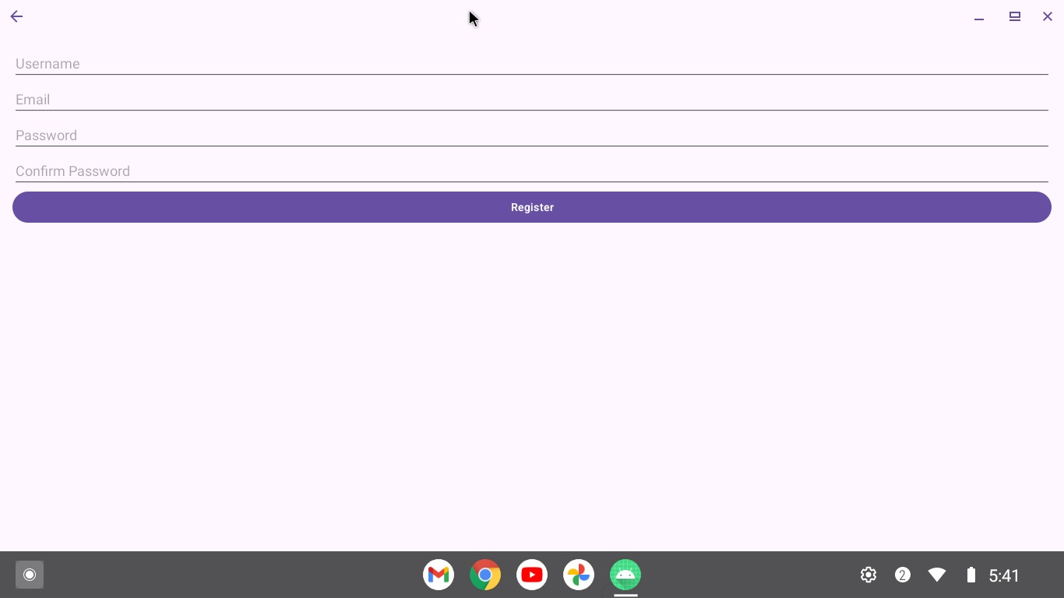
Register Page Results

Slide 9
User Dashboard
1. Policy Overview:
The user dashboard provides a comprehensive overview of our active insurance policy, including the coverage details, policy period, and premium information.
2 . Claims History:
We can easily view our past and pending claims, track their status, and access any relevant documentation or correspondence related to the claims process.
3. Personalized Notifications:
The app will proactively send you timely notifications about important events, such as upcoming renewals, payment due dates, or any changes to our policy coverage.

Slide 10
Policy Updates
Policy Updates:
Easily update our policy information, such as changes in our vehicle, address, or contact details, to ensure our coverage remains accurate and up-to-date.
Policy Documents:
Access and download our insurance policy documents, including the declarations page, coverage details, and any relevant riders or endorsements.
Customer Support:
Connect with our dedicated customer support team directly through the app, allowing us to address any questions or concerns we may have about our policy.

Slide 11
Claims Submission
1. File a Claim
Initiate the claims process by providing details about the incident, such as the date, location, and a brief description of the damage or loss.
2. Upload Documentation
Attach any relevant documentation, such as photos, repair estimates, or police reports, to support our claim and expedite the review process.
3. Track Progress
Monitor the status of our claim and receive updates on the review and approval process, ensuring you're always informed about the progress.

Slide 12
Settings Menu
Profile Management:
Manage our personal information, including our name, contact details, and password, ensuring our account remains secure and upto-date.
Notification Preferences:
Customize our notification preferences to receive timely updates and alerts about important events related to our insurance policy.

Slide 13
Language and Accessibility
The app offers the flexibility to change the display language and enable accessibility features, making it user-friendly for all customers.

Slide 14
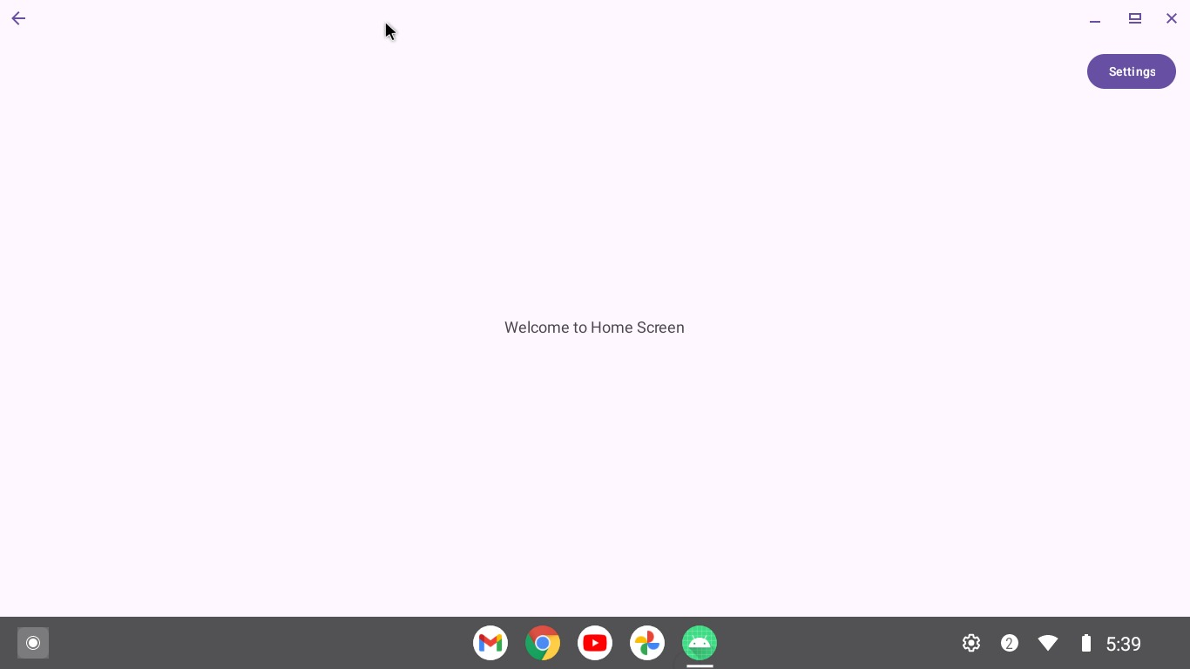
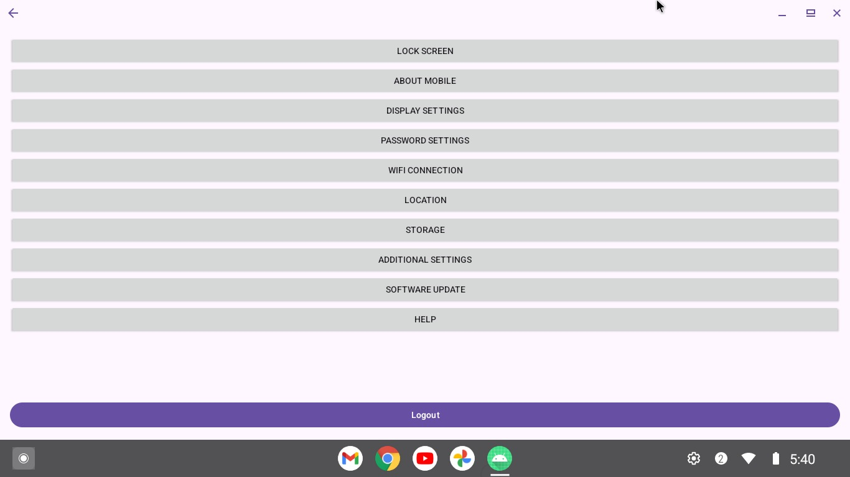
Results

Slide 15
Conclusion
Our innovative vehicle insurance app revolutionizes the way customers interact with their policies. By offering quick and easy policy management, real-time claims processing, personalized coverage recommendations, and usage-based insurance options, we're set to enhance the customer experience significantly.
This digital solution not only increases our operational efficiency but also provides valuable data-driven insights for more accurate risk assessment. As we prepare to launch this app, we're poised to gain a competitive edge in the digital marketplace.

